Slide 2
Writing for the Data Science at Microsoft publication on Medium.com
Casey Doyle
caseyd@microsoft.com
www.linkedin.com/in/caseydoyle1/

Slide 3
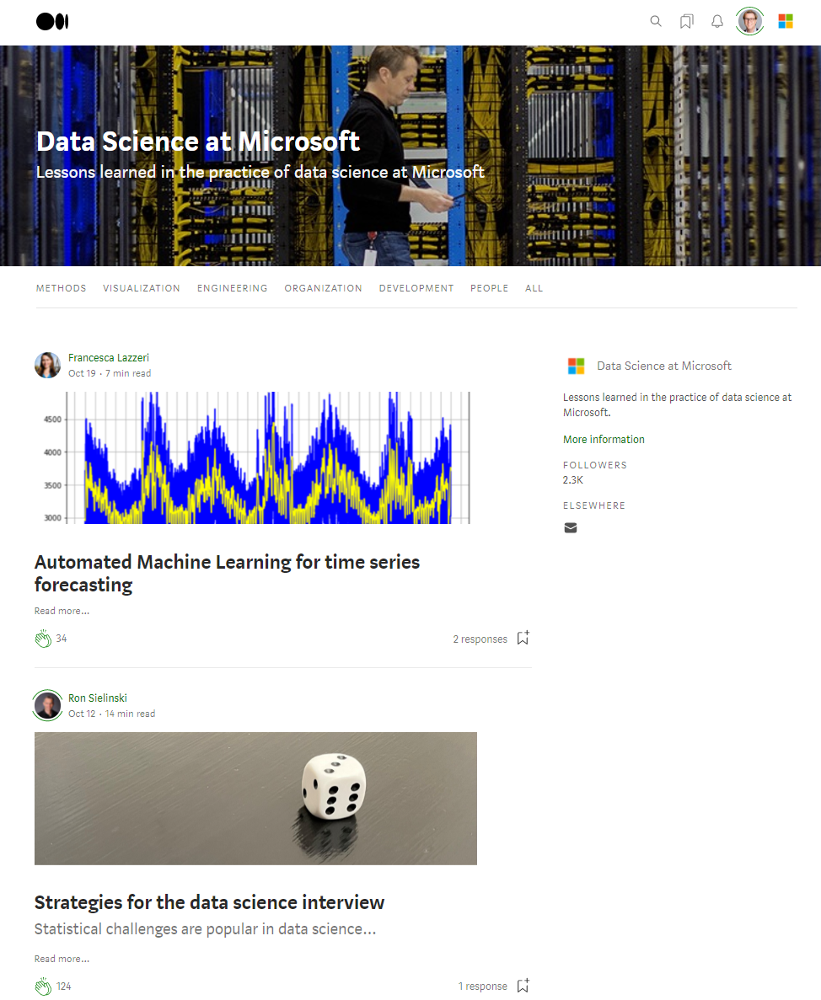
Writing for the Data Science at Microsoft publication on Medium.com
Casey Doyle
caseyd@microsoft.com
www.linkedin.com/in/caseydoyle1/

Slide 4


Casey Doyle Principal Data Scientist, Microsoft
Casey Doyle is Principal Data Scientist in the Microsoft Cloud Data Sciences (MCDS) organization in Microsoft’s Cloud+AI division. He specializes in data visualization and information presentation, and has worked in a variety of analytics roles at Microsoft. In his current role he is also the Managing Editor of the Data Science at Microsoft online publication on Medium.com, and oversees Knowledge Management for his organization. He has an MBA from the Foster School of Business at the University of Washington.

Slide 5
Session goals
Understand the role and importance of thought leadership in driving impact with data science
Learn about the Data Science at Microsoft (DS@M) online publication on Medium.com as a forum to add your voice, among other outlets also available to data scientists at Microsoft
Hear from Francesca Lazzeri, DS@M writer and published data science author, on her experience writing about data science and learn how you, too, can add your voice by writing about data science

Slide 6
How thought leadership helps drive data science impact
Data alone is not insight: Humans can tell a story better than data can by itself
Numbers rarely “speak for themselves”: They are effective when given context and are used in making findings, conclusions, and recommendations.
Data scientists with storytelling skills have greater business impact
Influencing for impact often comes down to conveying a compelling narrative around data and what it means
Demonstrating thought leadership within the data science discipline internally and within the data science community externally can help accelerate your career
Data scientists who develop this skill typically have the edge in getting their work noticed and acted upon, and enhance their abilities to be acknowledged as an expert by peers and leaders

Slide 7
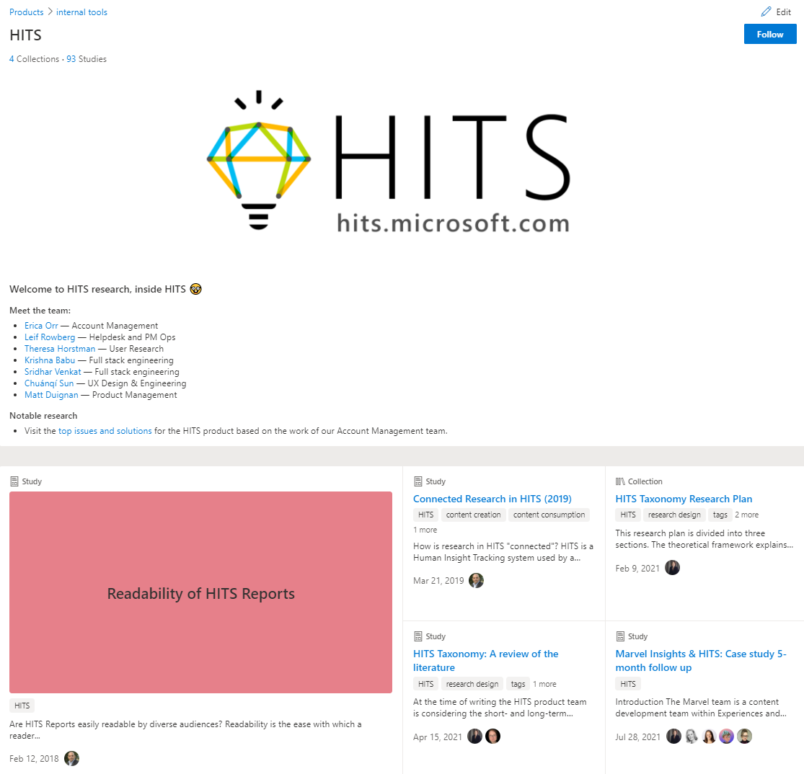
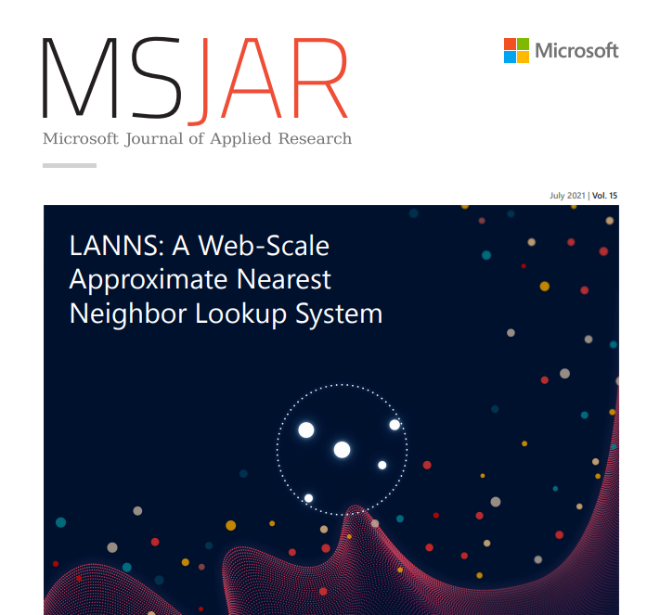
Some ways of sharing data science thought leadership at Microsoft…
Human Insights Team Studio (HITS) repository to find user research, market, and data science insights for human-centered product design
hits.microsoft.com/product/hits
Microsoft Journal of Applied Research (MSJAR) devoted to sharing Microsoft-internal research of a generally applied nature
https://microsoft.sharepoint.com/teams/MSJAR
Data Science at Microsoft (DS@M) external online publication of Microsoft thought leadership in data science, showing the value of data science work, and its business impact
medium.com/data-science-at-microsoft

Slide 9
Data Science @ Microsoft overview
Launched nearly two years ago, on January 9, 2020
Audience: Data scientists, business decision-makers, customers, partners, influencers, students, and prospective employees
More than 85 articles in six categories, with at least one article published each week in 2021
Categories include methods, visualization, engineering, organization, development, people
Nearly one-third of articles have been selected as Recommended by the editors of Medium.com (no connection to Microsoft)
Over 2,500 followers
Managing Editor: Casey Doyle (giving this presentation)
Authors from across Microsoft data science teams

Slide 10
What kinds of articles have done well on DS@M?
Cutting edge topics
Three-part article series “Causal inference,” by Jane Huang et al., have been among our best performing articles ever, with nearly 30,000 views in their first year.
“How we reduced our text similarity runtime by 99.96%,” by Omri Mendels, with nearly 7,000 vews since being published in March.
Useful techniques
“Introduction to feature engineering for time series forecasting,” by Franceca Lazzeri, with nearly 6,000 views since being published last month.
“Training EfficientDet on custom data with PyTorch-Lightning (using an EfficientNetv2 backbone),” by Chris Hughes, with nearly 3,000 views since being published in July.
“Bread and butter” data science basics
“Data science learning resources,” by Lisa Cohen et al., with more than 2,700 view since being published in June.

Slide 11
What can DS@M mean for you?
Opportunity to practice your data storytelling skills
Increase recognition of your work
Establish yourself as an expert in the wider data science community
Help build your career
Provide an outlet for an idea you want to pursue, and a platform for it to cohere more fully as you determine how to present it

Slide 12
Looking for new voices from across Microsoft
Engage with us
We welcome Data Science and ML voices from across Microsoft to contribute
What do data scientists, business decision-makers, customers, partners, influencers, students, and prospective employees want to know about that you can share with them?
Help readers with tangible, valuable knowledge and takeaways
Opportunity to share your code
Writing process
Length: Typical articles start at 1500 words
Tone: Engaging and professional, approaching from an angle of how Microsoft uses data science to nurture customers and improve products and information about them
Perspective: Customer-friendly without being competitor-friendly
Support: Article development consultation, editing, illustration, and editorial style guide
To get started, contact caseyd

Slide 13
Key learnings and insights
Thought leadership helps drive data science business impact
Understanding how to tell data science stories furthers your data science career
Writing about data science, for DS@M and other Microsoft outlets, is a great way for you to contribute to building data science thought leadership inside and outside Microsoft
Write for DS@M today! aka.ms/ds@m
Contact: caseyd

Slide 14

Discussing data science writing with Francesca Lazzeri
Principal Data Scientist Manager at Microsoft, Adjunct Professor at Columbia University
Author of the book Machine Learning for Time Series Forecasting with Python (Wiley) and many other publications, including technology journals and conferences
Author of a recent three-part DS@M article series on time series forecasting
www.linkedin.com/in/francescalazzeri/

Slide 15

To read us: aka.ms/dsam
To write for us: Contact caseyd

